Slide 1
Bioinformatics
Lecture 1
Introduction 16/1/2021
Indian Institute of information technology

Slide 2
Course outline
Refer to the pdf document posted online
13 lectures
2h sessions
Contact details: SAILATHA RAVI, PhD
Sailatha.r@iiits.in

Slide 3
Course policy and requirement
Attendance is compulsory
You must write up assignment solutions on your own.
Late assignments will lose 10% per day, up to 5 days, after which they will not be accepted

Slide 4
Goals of this Course
● Introduce some biological terminology – Present the algorithms pursued by natural process
● Present some areas of bionformatics
● Provide an overview
● Show that there are interesting algorithmic & computational problems
● Provide you the knowledge you need to work on research projects
Requirements
Be curious
Ask questions
Discussion among peers
Some basic knowledge on statistics and algorithms could help

Slide 5
Text Books
Bioinformatics- Sequence and Genome analysis, David. W. Mount
An Introduction to Bioinformatics Algorithms, Neil C. Jones and Pavel A. Pevzner
Additional reading materials and work sheets will be provided.

Slide 6
Course Structure
Introduction & biological Terminology (2 lectures)
Genome
Central dogma, DNA protein and RNA
Genetic code and protein code- Database search [1/2 lectures]- Disease predictions, SNPs
Sequence Analysis (3 lectures)
Pair-wise Sequence alignment
Searches on strings
Multiple Sequence Alignment
Phylogenetics (2 lectures)
Parsimony
Likelihood
Discrete operations on trees
Structure prediction [2 lectures]
RNA
DNA
Protein folding problem
Special topics and current trend in Bioinformatics [1-2 lectures]
Cancer, Pharmacogenomics [1 lecture],
Population Genetics (1 lecture), Interactome
Class Group assignment presentation [1 lecture]
Course revision (1 lecture)

Slide 7
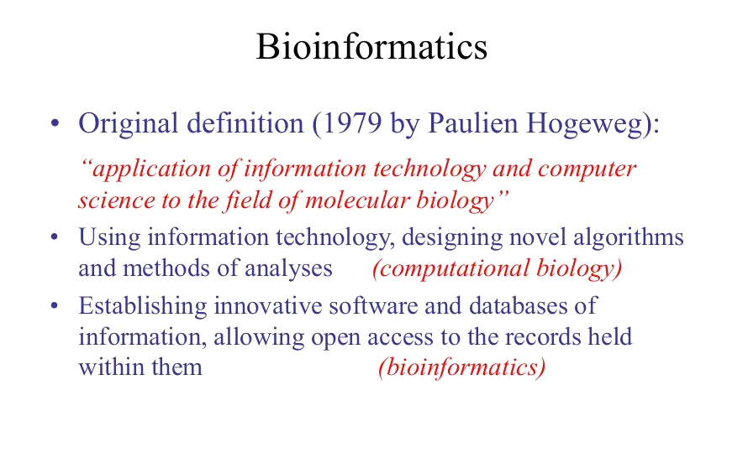

Slide 8
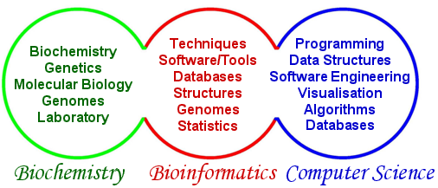
Bioinformatics- Prospective future

Slide 9
What does biology have to do with computers?
Huge amount of data: too much to analyze by hand, lots of mystery left about how life works.
Requires clever algorithms to:
• ﬁnd interesting patterns • store / search / compare • visualize vast collections of data • predict missing or hard-to-observe features (like protein structure or evolutionary relationships)
Nearly all molecular biology is now “computational biology”: biologists depend on computer scientists every day.

Slide 10
Algorithms
Algorithms- A set of specific instructions to define and solve a problem
Programming- Using programming languages to code/implement the specific set of instructions
“The benefit of using a computer is not to solve an insolvable problem but to arrive at a solution more quickly and accurately than a human can”.

Slide 11
What is Bioinformatics?
The use of techniques from mathematics, statistics, and computer science to solve biological problems
Many activities of the cell can be interpreted as manipulation of strings from a small alphabet
Things we will not be studying
How to use cells to perform computation
How the cells perform the computation
Instead, we will be studying computations that can help us
Find genes that are similar - Pattern matching
Finding Transcription Factors – Motif discovery
Aligning Genes from different organisms – Multiple Alignment
Retracing evolutionary history - Phylogenetic trees
How reactions are facilitated - Protein folding
11
Notes:
11

Slide 12
Workflow
Experimental observations
Identifying patterns or mismatches with speed and accuracy
Building models
3D representations
Predicting missing or hard to observe features that aligns with known scientific principles
Accumulation of results
Databases
Interpretation- Deriving scientific principles
Technological advancement

Slide 13
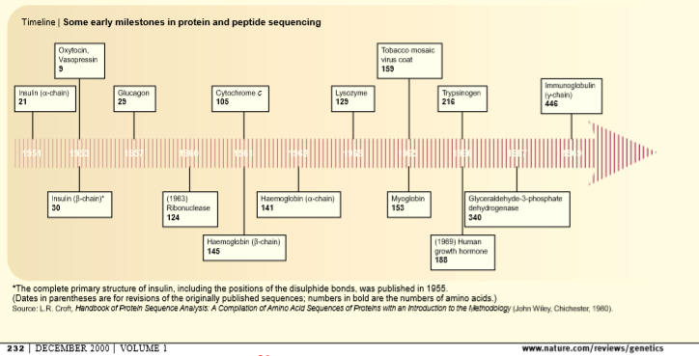
History of Bioinformatics
Computers role in molecular biology recognized as early as 1960s- Data from Protein chemistry
The scientists contributed to the conceptual and technical foundation
1955 By Sanger et al., at Cambridge University- 1958 Nobel prize in Chemistry
Semi-automated machine by Stanford Moore and William Stein- reduced the time to half.
Late 1960s- Automated ‘Sequenator’ by Edman

Slide 14
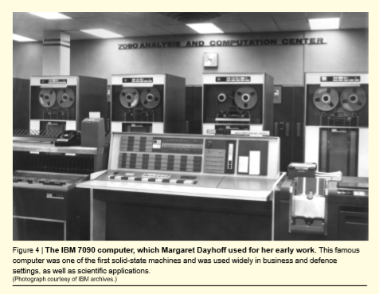
History of Bioinformatics
Computer technology + Mathematics + Molecular Biology- → Life sciences
1) amino acid sequences
2) Macromolecular information- conceptual link between molecular biology and computer science→ led to Information theory
3) Availability of high speed digital computers developed during the second world war became available
Margaret Dayoff- used FORTRAN to deduce the protein sequence using overlapping peptides

Slide 15
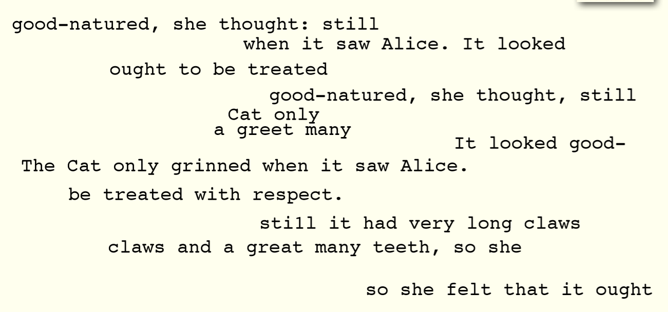

Slide 16
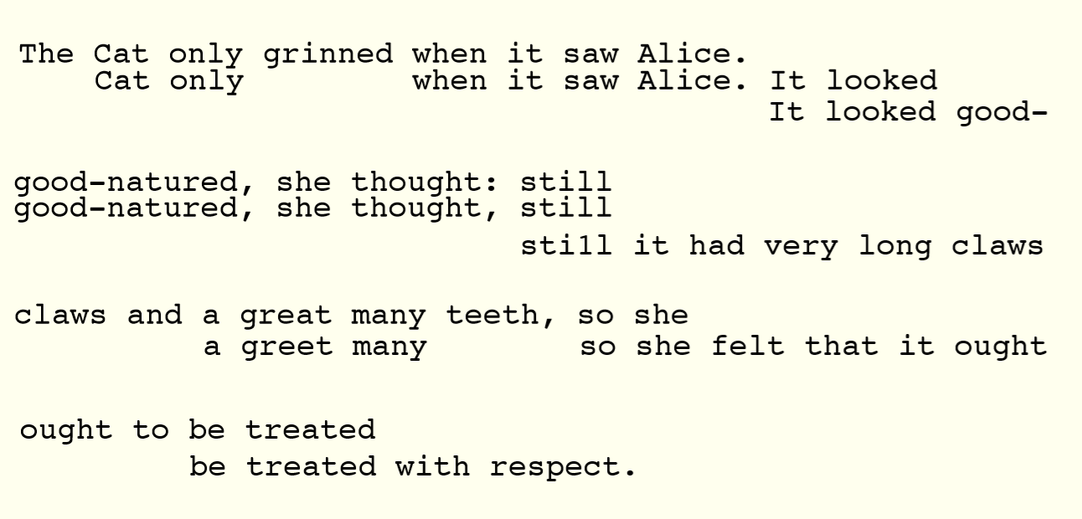

Slide 17
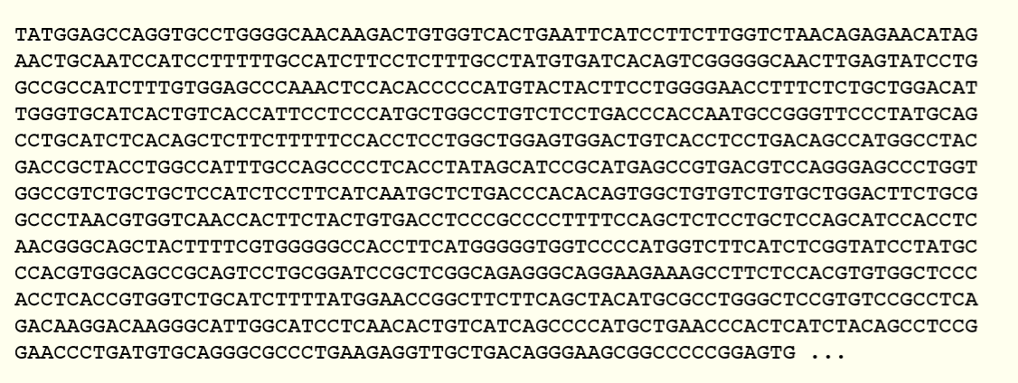
Genome
Genome of the Cow
a sequence of 2.86 billion letters enough letters to ﬁll a million pages of a typical book
What does it mean?
Identify patterns.

Slide 18
Computational Successes
Genome assembly
Gene discovery
Understanding the origin of swine flu
Predicting protein structure
https://fold.it/portal/info/about
First genome sequenced in 1995 (the bacteria H. inﬂuenzae with a genome of 1,830,140 letters). • 1st draft of human genome ﬁnished in 2001 (~ 3 billion letters)
• Now: Over 1100 bacterial genomes
• Hundreds of higher-order genomes done or in progress.
• Several complete human genomes ﬁnished.

Slide 19
Topics of interest
Cancer
https://www.youtube.com/watch?v=0PX5UBuvk_w
Genetic Disorders
https://www.youtube.com/watch?v=hOfRN0KihOU
Evolution
https://www.youtube.com/watch?v=wvTv8TqWC48
Protein Engineering and Drug Interactions

Slide 20
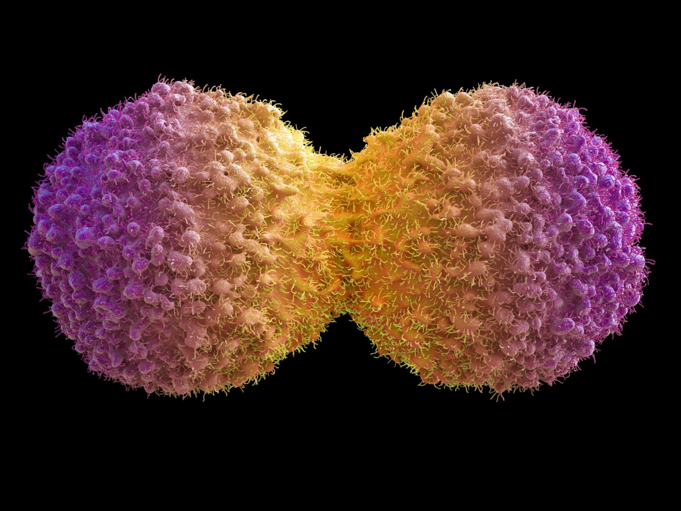
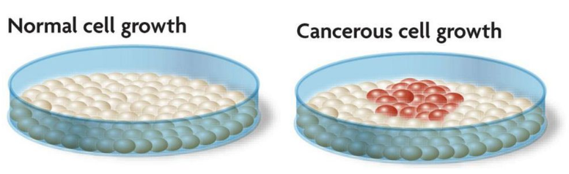
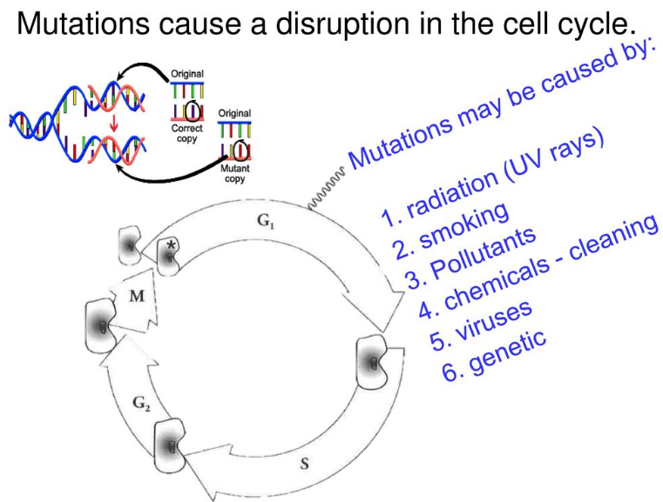
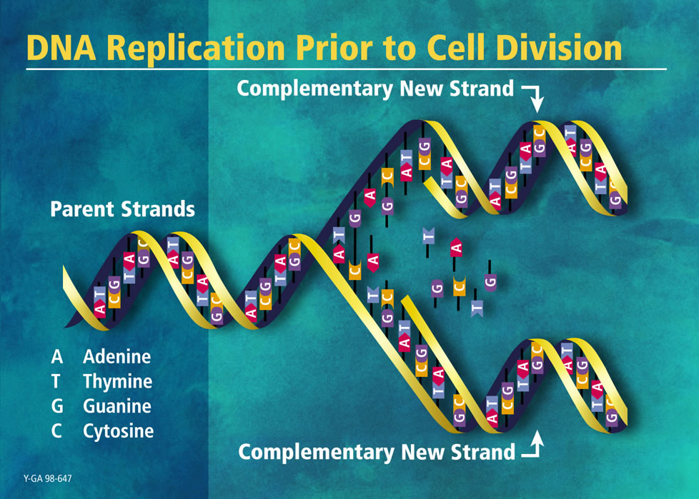
Cancer cells
1. Checkpoint
2. Chemical signals tell it when to stop replicating
3. Space constraints
Apoptosis
Cell death

Slide 21
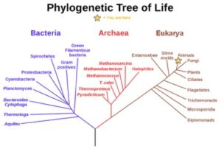
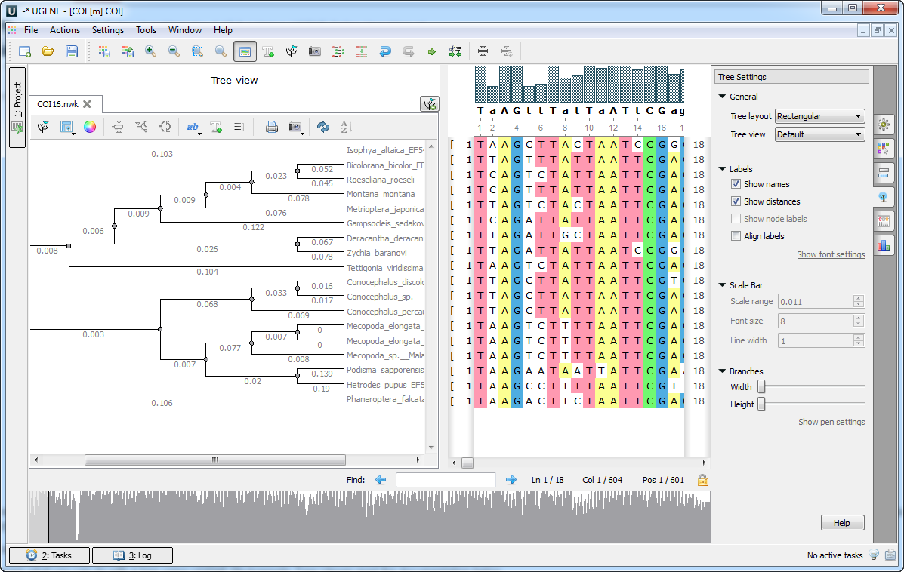
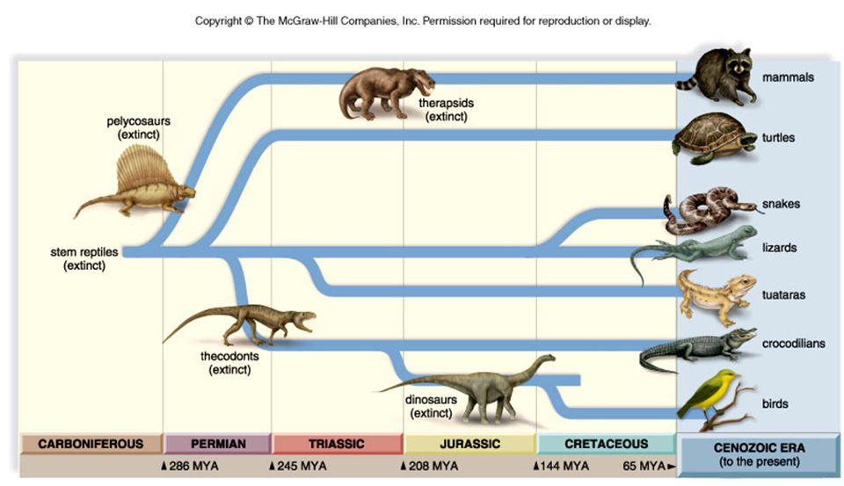
Phylogenetic tree

Slide 22
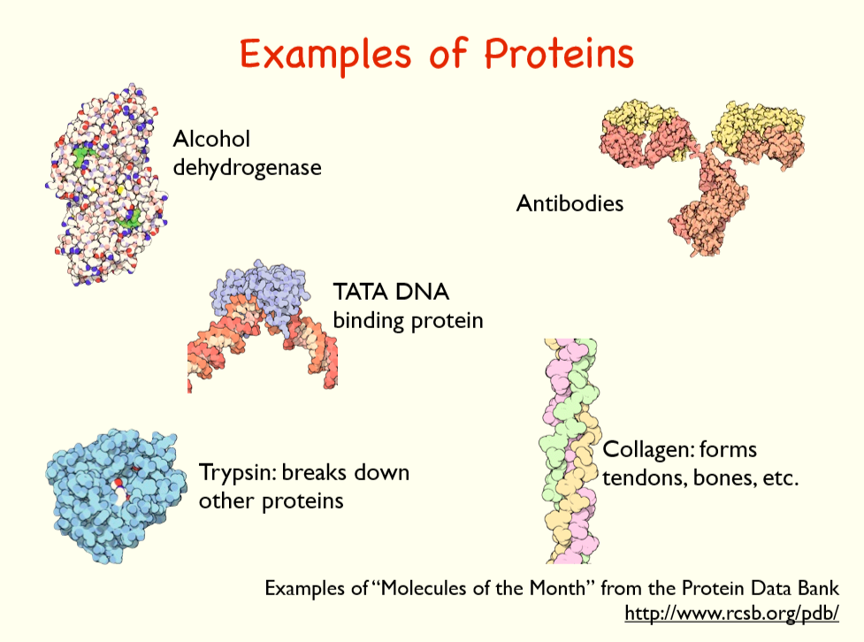
Protein structure prediction

Slide 23
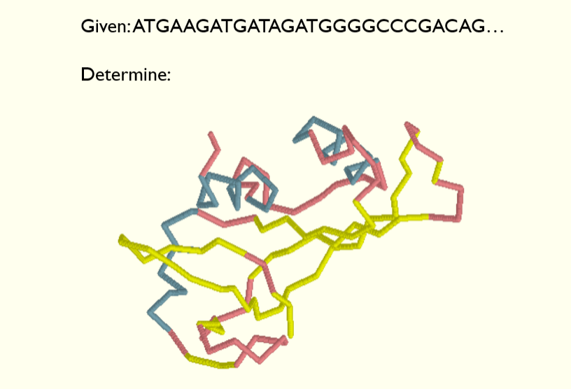
Predicting Structure

Slide 24
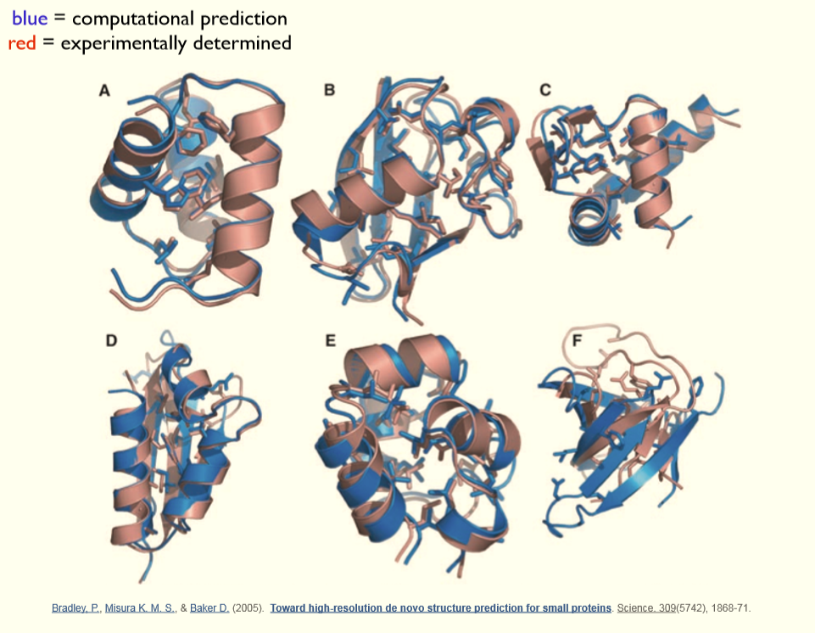
Protein folding

Slide 25
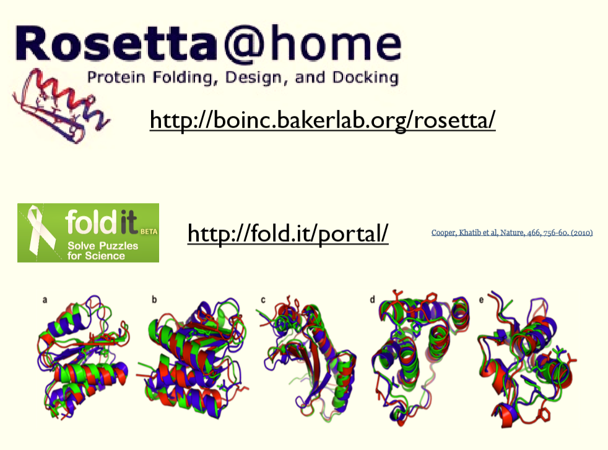
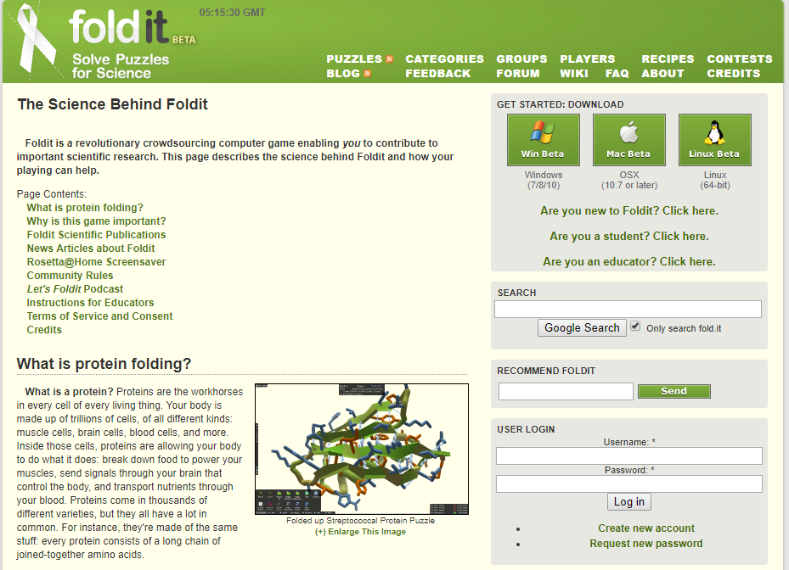
Protein folding online platforms
https://fold.it/portal/info/about

